Slide 1
A regional trauma informed response to children's exposure to violence.
Law Enforcement – Roll Call

Slide 2
Children are Exposed to Trauma
A recent national survey found that 60% of U.S. children have been exposed to violence, crime, or abuse in their homes, schools or communities
40% were direct victims of two or more violent acts.

Slide 3
Trauma’s Impact
Trauma in children turns off the learning switch and turns on risky behavior.
Kids at risk tend to skip school, use drugs, become violent, commit crimes, and end up meeting law enforcement.

Slide 4
A Solution:
Handle With Care
The “Handle With Care” program enables police or first responders to notify schools if they encounter a child at a traumatic scene.
This allows schools and mental healthcare leaders can provide trauma-sensitive support right away, to help kids succeed.
Handle With Care is funded by the St. Louis Area Violence Prevention Commission.
Proactive not Reactive

Slide 5
It’s easy to make a difference. When you notice a child at the scene of an incident, gather three things:
Ask for the child’s full name.
Ask what school the child attends.
Ask the child’s date of birth.
1
2
3

Slide 6
When to send a HWC Notice?
Arrest of a household member
Search warrant served in residence
Incident of domestic violence
Death/suicide of family member
Physical/sexual abuse
Forced displacement from residence
Community violence
Drug/alcohol overdose of a family member
House fires
Anytime a child is present!

Slide 7
Send HWC notice before the start of the next school day!
When the school is notified, school staff will then “handle the child with care” and provide trauma sensitive supports so the child can feel safe and learn.
With parental consent, mental health services are available for those children who need further supports.

Slide 8
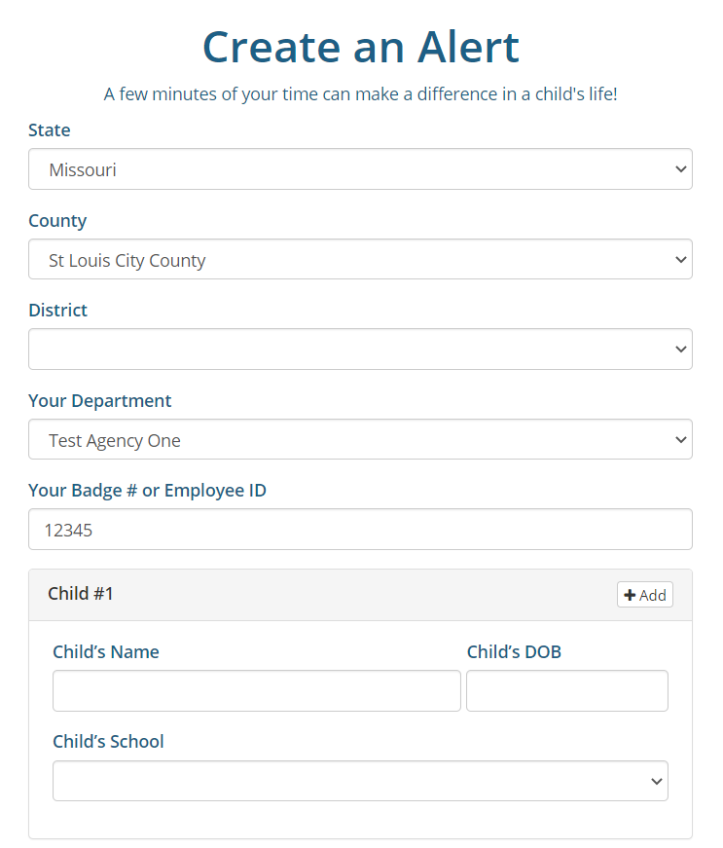
From Your Web Browser visit www.handlewithcarestl.org/law-enforcement

Slide 9
HANDLE WITH CARE ALERT
Alert #2046 8/16/2021 7:47:02 PM One or more children were on the scene of a potentially traumatic incident within the past 24 hours and could exhibit academic, emotional and/or behavioral problems as a result.
“please handle him/her with care”.

Slide 10
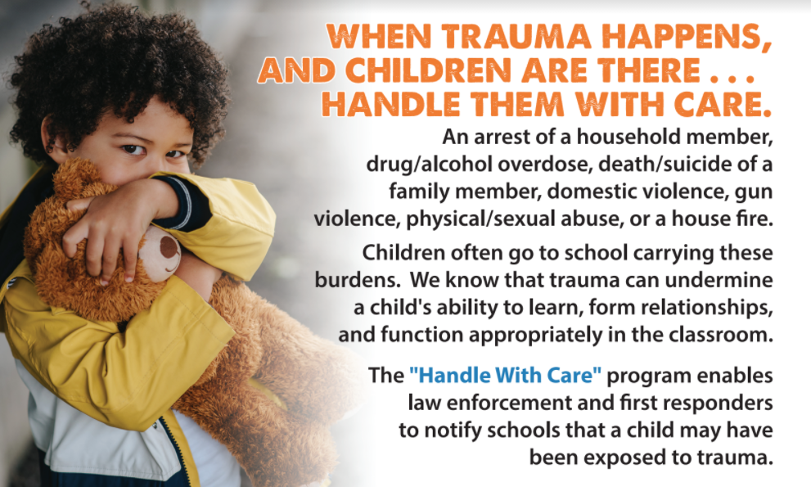
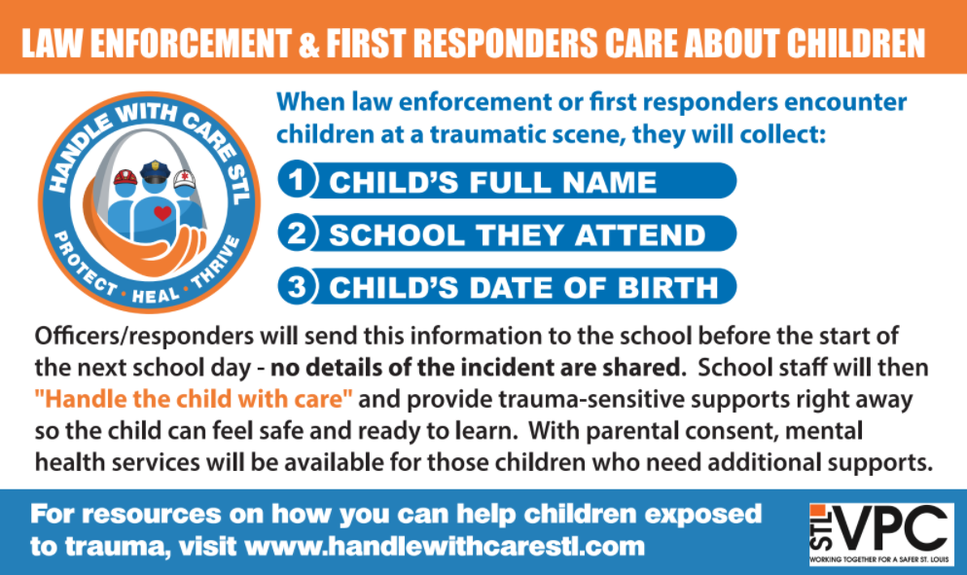
3x5 Community Index Card
(fits in your shirt pocket)

Slide 11
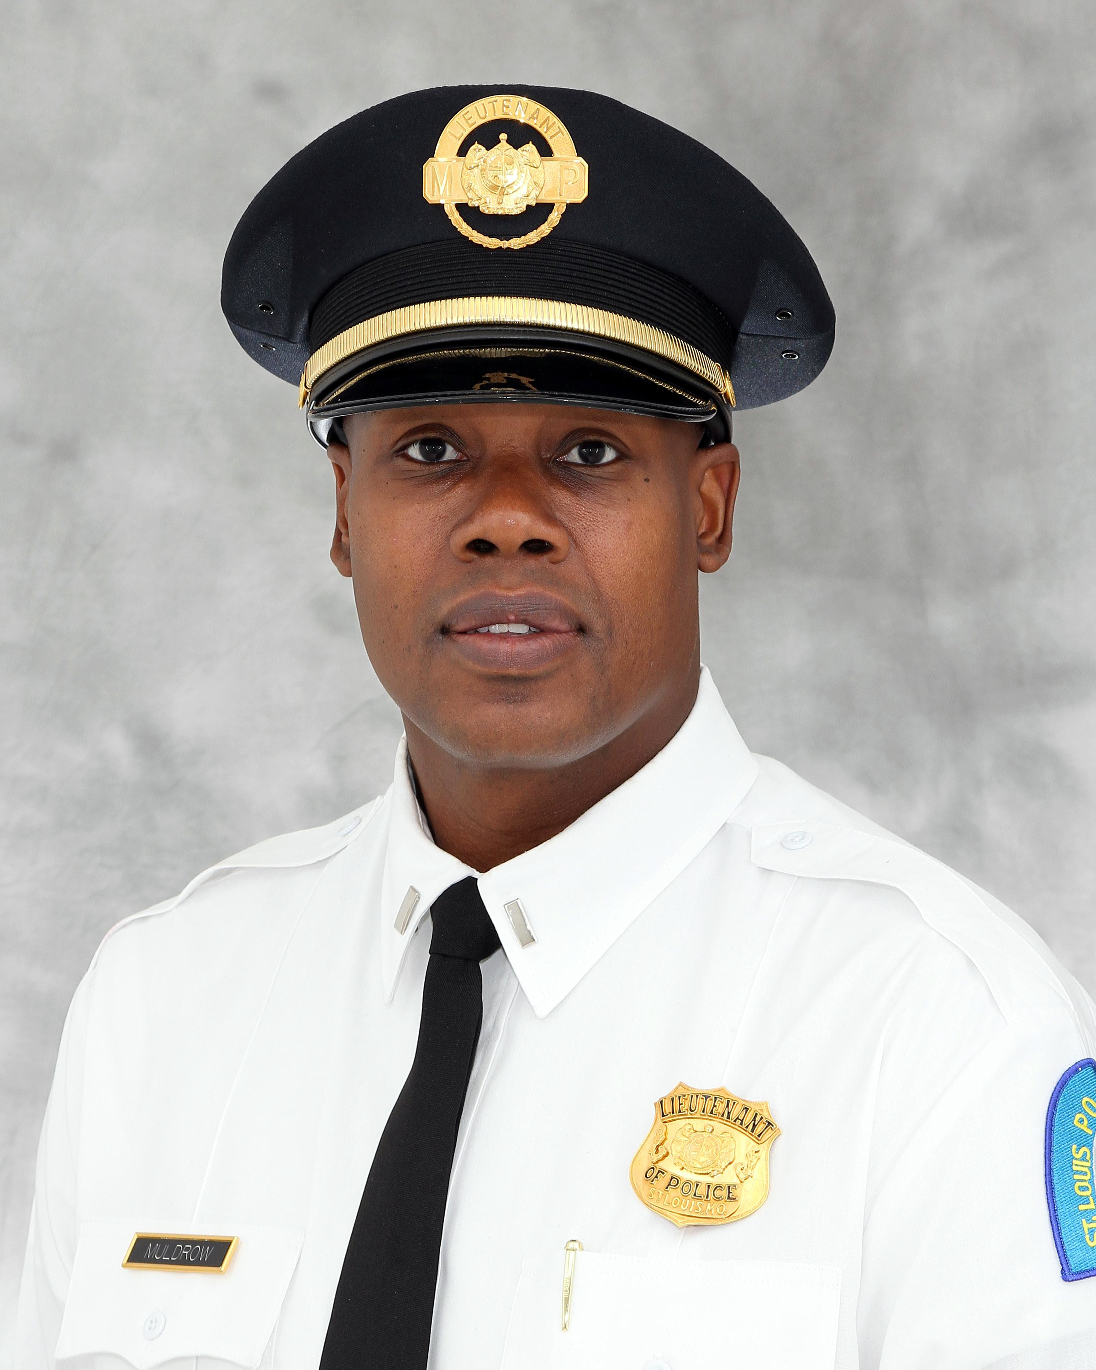
Program Contacts
Lisa Potts, Sr. Project Director
St. Louis Mental Health Board
lpotts@stlmhb.com
314-535-6964 ext. 15
Lieutenant Thomas Muldrow
Commander, Juvenile
tmuldrow@slmpd.org
314-444-5891

